Slide 1
Part 1 - End to End Pipeline: SCM and Build with demo
Nelson Lopez
Z DevOps Acceleration Team
Alisa Morse
Offering Manager, Z DevOps

Slide 2
Disclaimer
IBM’s statements regarding its plans, directions, and intent are subject to change or withdrawal without notice and at IBM’s sole discretion.
Information regarding potential future products is intended to outline our general product direction and it should not be relied on in making a purchasing decision.
The information mentioned regarding potential future products is not a commitment, promise, or legal obligation to deliver any material, code or functionality. Information about potential future products may not be incorporated into any contract.
The development, release, and timing of any future features or functionality described for our products remains at our sole discretion.
Performance is based on measurements and projections using standard IBM benchmarks in a controlled environment. The actual throughput or performance that any user will experience will vary depending upon many factors, including considerations such as the amount of multiprogramming in the user’s job stream, the I/O configuration, the storage configuration, and the workload processed. Therefore, no assurance can be given that an individual user will achieve results similar to those stated here

Slide 3
Agenda
Introduction (30 min)
Customer challenges & solution alignment with overall Nazaré strategy
Capabilities - 2019 New & Noteworthy- 2020 roadmap
Introduction to pipeline Builds with DBB
What is a Pipeline
DBB Build
User Build
Part 2 A closer Look
SCM (Git) Concepts / Terminology
What are Git Workflows
Git repositories
Git branching strategies
DBB and Scripting
A Pipeline Demo
Notes:
Alisa Start- slides 1-13- Intro- through DBB user build Intro to SCM, GIT… Nelson Start from slide 14 ++

Slide 4

The 6 core DevOps capabilities mapped to the sales plays
Continuous Integration
Discover and unleash IBM Z through API’s
Improve speed and quality
Optimize Cost and Skills
{...}
$
Automated Testing
Bring your own IDE
Enterprise class discovery and intelligence
Enterprise wide standardization with an open pipeline
Dependency Based Build
On demand development and test environments
Notes:
IBM identifies 9 core competencies that have helped enterprises successfully navigate in their journey to cloud, and address challenges with Managing Hybrid cloud environments, drive resiliency and optimizing costs and skills. Maturity in the 9 core competencies also result in organizations break the silos and achieve AI driven Operations (aka AIOps). The 9 core competencies are
Monitor and analyze hybrid Infrastructure for health, availability, performance for the entire system and sub-systems, to help IT Operators proactively identify issues that can result in downtime or other performance issues.
Automate to improve quality of service with a single point of control and integrated workflow across provisioning and management of hybrid cloud platforms.
End-to-end Application visibility for application performance, for faster problem isolation and minimizing costly war rooms.
4. Enhance infrastructure resiliency by automating to respond to events / triggers and to guarantee continuous availability.
5. Ensure workload resiliency by ensuring faster time to recovery from batch workloads failures.
6. Proactively identify and resolve issues. Artificial Intelligence and Machine learning are paving the way for enterprises to detect anomalies in the system faster, and remediate them quickly before they even happen.
7. With the looming retirement for the Mainframe administrators, and the new generation of IT Operators coming onboard – it is critical to bridge the skill gaps quickly. Many next generation IT Operators aren’t familiar with the 3270 interfaces, and are more used to mobile apps or web browsers. Bridge skill gap is an important competency helping collaboration and bridging skill gap between the 2 generations of IT Operators
8. Optimize Workload performance helps enterprise leverage licensing models that align with the Hybrid Cloud e.g Tailor Fit Pricing and also identify and optimize performance issues impacting their costs.
9. Finally, enterprise must be able to Forecast the performance and capacity needs for their system, to deliver optimal customer experience while staying compliant.

Slide 5

A typical developer workflow
Deb, new z/OS developer
At school I learnt to develop JAVA with Eclipse, but I could also use my favorite editor I downloaded from the web.
I am used to write a unit test for all my programs, that makes it easier and saver to modify them in the future.
Test coverage for JAVA is great. It tells me, if my tests also hit the changed code. I wish I could use that in COBOL.
I received a task to fix a defect, so I start cloning the repository of my application it to my work environment
I create a new branch for this activity, so I can work in isolation, and not being disturbed by the development activities of my team
In my IDE I use IBM DBB user build to compile / link and unit test the program
Then I commit and push my branch to the central git repository along with my commit.
Let’s have a team mate to review my change. I create a pull request to merge my changes to the common branch of his team
The pull request needs to be approved
It triggers a build which runs a set of tests and code scans
After I am done with the pull request, I delete my personal branch; on the integration branch a full pipeline build it performed, so I can move the changes forward or associate them to a release.
Let me explain you how I would like to work :

Slide 6

Consistency with overall Nazaré Strategy
Deb can use services to perform her daily tasks of code, build and debug leveraging open and familiar developer tools.
Deb can run integration tests and deploy the changes to the next level using open source tools in a unified and automated pipeline.
SCM Integration
IDE/Debug
Build/Test
Provisioning
Insights
Deploy
Import or create project
Modern SCM integration
Bring your own IDE
Impact Analysis insights
Dependency Based Build
Automated test
Self service provisioned environments
Application performance insights
Environment monitoring
Graphical dashboard for run time statistics
Commit to SCM
Deploy to traditional and containerized environments
Git, RTC
IDzEE, VS Code, Eclipse Che
Jenkins, IDzEE/DBB, ZUnit (IDz/IDzEE)
Scripts, UCD
Ansible, Kubernetes
TBD
Integration with open and familiar tools
Automated Pipeline across multi-cloud platforms

Slide 7
Git / IBM Dependency Based Build Value Proposal
For z/OS Development Shops who :
Want to address hybrid platform development challenges : synchronization for multi-speed development ; deployment, collaboration and reporting across platforms,
Want to reduce cost of legacy tooling compared to platforms using Open Source,
As Agile Adopters want to bring Continuous Integration, Continuous Delivery and multi-stream development processes to the mainframe but lack tools to support them.
DBB provides a Build System which can intelligently build z/OS applications by :
Building traditional z/OS artifacts using open distributed pipeline of GIT and Jenkins like it is done in distributed,
Loading the required dependencies and build all impacted programs based on a change.
That will bring the following benefits :
Rapidly deploy heterogeneous tooling on all platforms to provide collaboration and aid synchronization
Minimize build and administration costs
Accelerate z/OS development using Agile and LEAN techniques like Continuous Integration to speed up development

Slide 8
Introduction to DBB builds Terminology
DBBs User Build is part of IDz and ZOD and enables the mainframe developer to build a single program. It will transfer the files from the local clone to Unix System Services and leverage the DBB build framework to compile and link it to personal libraries.
A Pipeline build is driven through the CI Orchestrator (Jenkins, TeamCity, Bamboo, etc.) and runs fully automated w/o any user interaction required. It is embedded in the workflows of the pipeline orchestrator and the git provider – like a mandatory clean build on a pull request, or an automatically triggered build after a new commit to the central git repository.

Slide 9
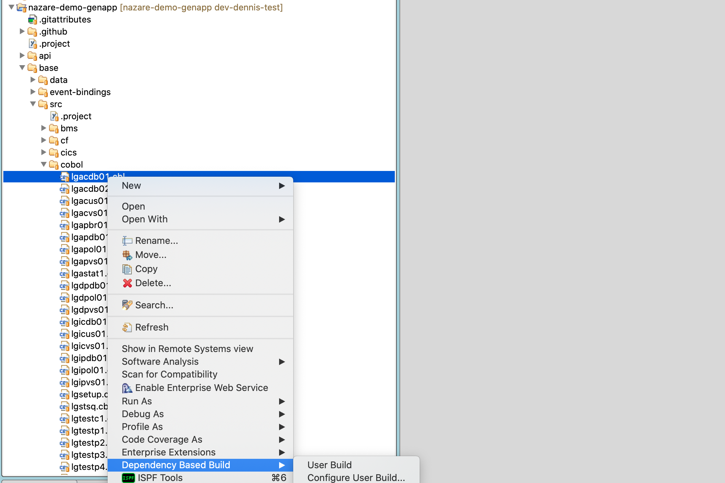
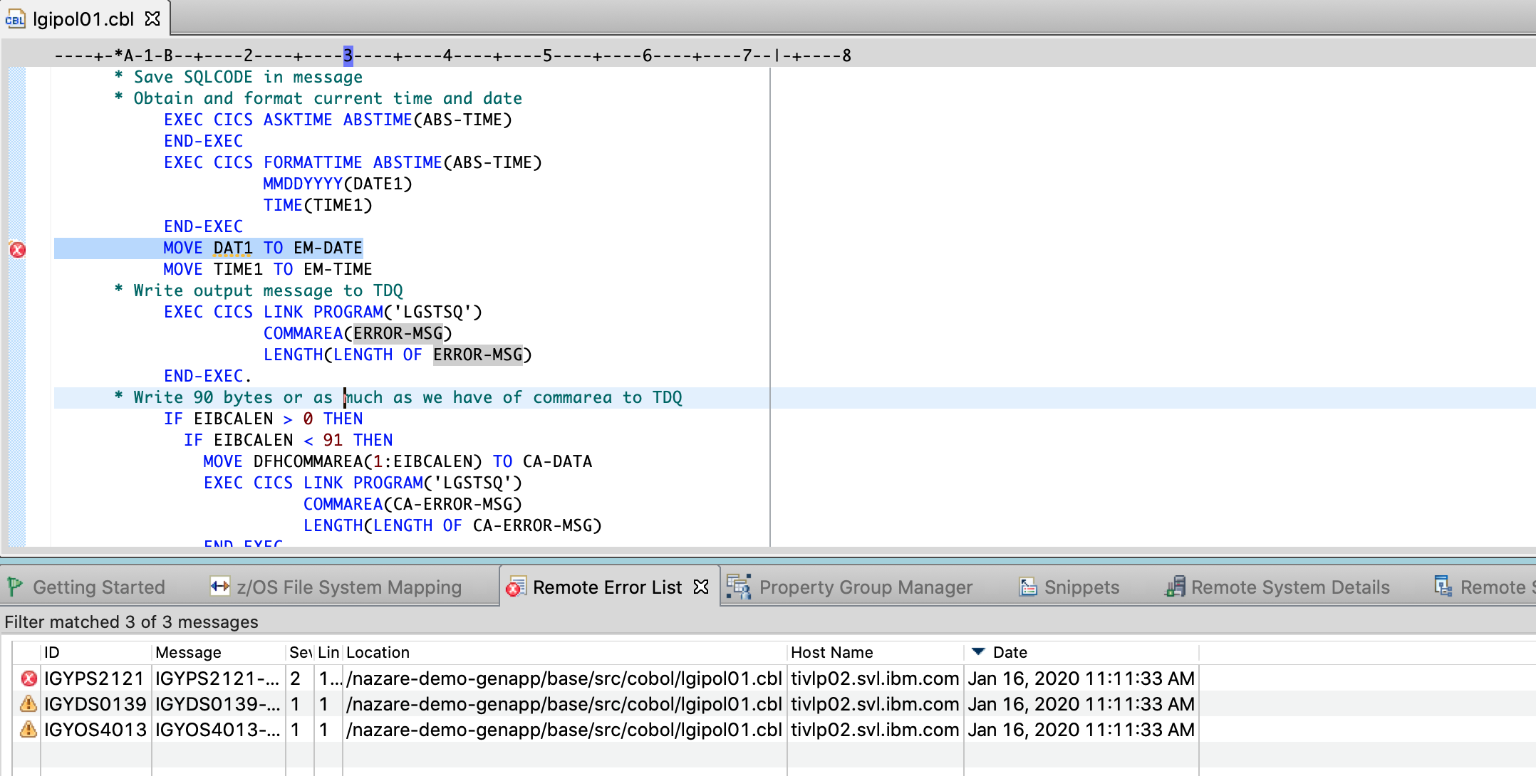
DBB User Build
DBB User Build was simplified in in 14.2
DBB Actions in context menus are available if the .project file contains dbb nature:
Dialogues are used to set a default User Build Configuration
Integration with Remote Error List like in Remote Syntax Checks
<?xml version="1.0" encoding="UTF-8"?>
<projectDescription>
<name>nazare-demo-genapp</name>
<comment></comment>
<projects>
</projects>
<buildSpec>
</buildSpec>
<natures>
<nature>com.ibm.ftt.dbbz.integration.dbbzprojectnature</nature>
<nature>com.ibm.ftt.ui.views.project.navigator.local</nature>
</natures>
</projectDescription>

Slide 10
DBB - New & Noteworthy in 2019 / Coming 1Q20
1.0.4 Mar. 19
1.0.5 Jun. 19
1.0.6 Sept. 19
1.0.7 Dec. 19
1.0.8 Mar. 20
DBB Core
zFS dir. ref. in DD statement
FIPS Compliance
Messages Doc
tar/gzip support for dependencies
Non-roundtrippable characters detection
zLinux support
DB2z & customized schema support
File Tagging in Enhanced ASCII
ASA print codes support in Copyto HFS
Samples
SCLM Migration
Assembler Hello World
JCL to Groovy
zAppBuild
ISPF Git Client
Merge Data Sets (with ZOAU)
DBB Build in GIT ISPF Client
ZOAU
MVS program execution
Data set manipulation
JES utilities
Submit Operator Command
Display Console log
System Concatenation Utilities
Dtouch, mvscmd, dwhence, dzip/unzip (enhancements)
Error handling
ZOAU is currently a DBB & IDzEE FMID
ZOAU standalone announced 2/18/20 to underpin Red Hat Ansible Certified Content for IBM Z
Notes:
Goal of the slide is awareness- these are real links to documentation.
Highlight... in 2019 we learned from our customers:
1. zAppBuild- when we deployed samples in early 2019, we realized that customers didn't understand the scripts. Clients saw all the build plumbing... new version of the scripts- zAppBuild- to ease deployment and adoption of scripts by build manager. DAT gave the input to zAppBuild- to ease the life of services and tech sales.
Next- ZOAU

Slide 11
Z Open Automation Utilities
Problem
Job Control Language (JCL) has been used for a long time for performing or automating a set of steps on the z/OS operating system. Though JCL has evolved with the times, it is foreign to people familiar with environments such as Linux, UNIX, and Windows
z/OS developers can write scripts to automate tasks in the UNIX System Services (USS) environment.
But there are gaps in what can be accomplished from USS i.e. accessing data sets or running MVS programs
sh package
64-bit Utilities Shared Library
sh code
C wrappers
Java library
Java Code
Java
C wrappers
Python library
Solution
ZOA Utilities fills in the gaps by providing the underlying runtime to support executing automation tasks on z/OS via Java, Python, and shell commands from USS.
With ZOA Utilities, you can run traditional MVS commands, such as IEBCOPY, IDCAMS, and IKJEFT01, as well as perform a number of data set operations in the scripting language of your choice.
ZOA Utilities is useful for z/OS developers who want to automate tasks that access MVS resources.
Python Code
Python
C wrappers
Language library
Language Code
Language
C wrappers
Notes:
64 bit library is written in C- good performance.
Java is an historic pain point.
ZOAU has the way to address various languages.
Both DBB and ZOAU opens the door beyond JCL- ZOAU will be announced. Ansible modules will be announced at Share.
No link between products

Slide 12
DBB 20Hx Candidates
Support more languages
Introduce a groovy DSL for build
DSLs provide concise declarative syntax for easy scripting of builds
The Groovy language provides APIs to easily create and parse DSLs
Gradle and the Jenkins declarative pipeline syntax are examples of a Groovy DSL
Support Gradle
Gradle is a popular Java-based build automation language
Similar to Maven it relies on conventions
It can take advantage of groovy
Support Python
Python is the most popular scripting language, and is not Java based
ZOAU offers Python API
We would need to offer non Java implementation for build logic or access to new services
Integrate with more workflows
Impact analysis and search across all mainframe assets is the start of most developer workflows
DBB captures dependency information related to a build scope
But there are plenty of build scopes and no UI
IDz could offer a UI
zAppBuild enhancements - more tuning to the build
A copybook change is treated as always impacting. It may not be (change a comment)
Programs may need to rebuild because of build rules change (aka compiler option)
Compile options at program level
Technical investigations
Limit the dependence on the web app (seen as a point of failure by some)
Assess our scanners
Facilitate the use of DBB in a non z/OS agent orchestrator technology
Azure, GitLab, bamboo, etc. don’t have an agent running on z/OS
Our solution is to ssh from a non z/OS agent to the mainframe
Some facilities of an agent are missing (git plugins, log uploads etc.) and will need attention
Decouple Build and packaging
As of now, packaging is a final step of a build relying on the build report
We could decouple this more (specific step, different scope)
Notes:
Point of slide- discussion. Priorities for 1H- Gradle and Python

Slide 13
Section 2
SCM (Git) Concepts / Terminology
What are Git Workflows
Git repositories
Git branching strategies
DBB and Scripting
A Pipeline Demo
Notes:
Nelson – Intro to this section
Mention this is part 1 or 2 parts –
today we’ll talk about git, DBB and end with a demo
tomorrow we will cover Repo structures, Migration packing and deployment
Explain it’s a lot of material to cover in 3 session ..
My goal is to help you understand the terminology and concepts to have more meaningful client engagements

Slide 14






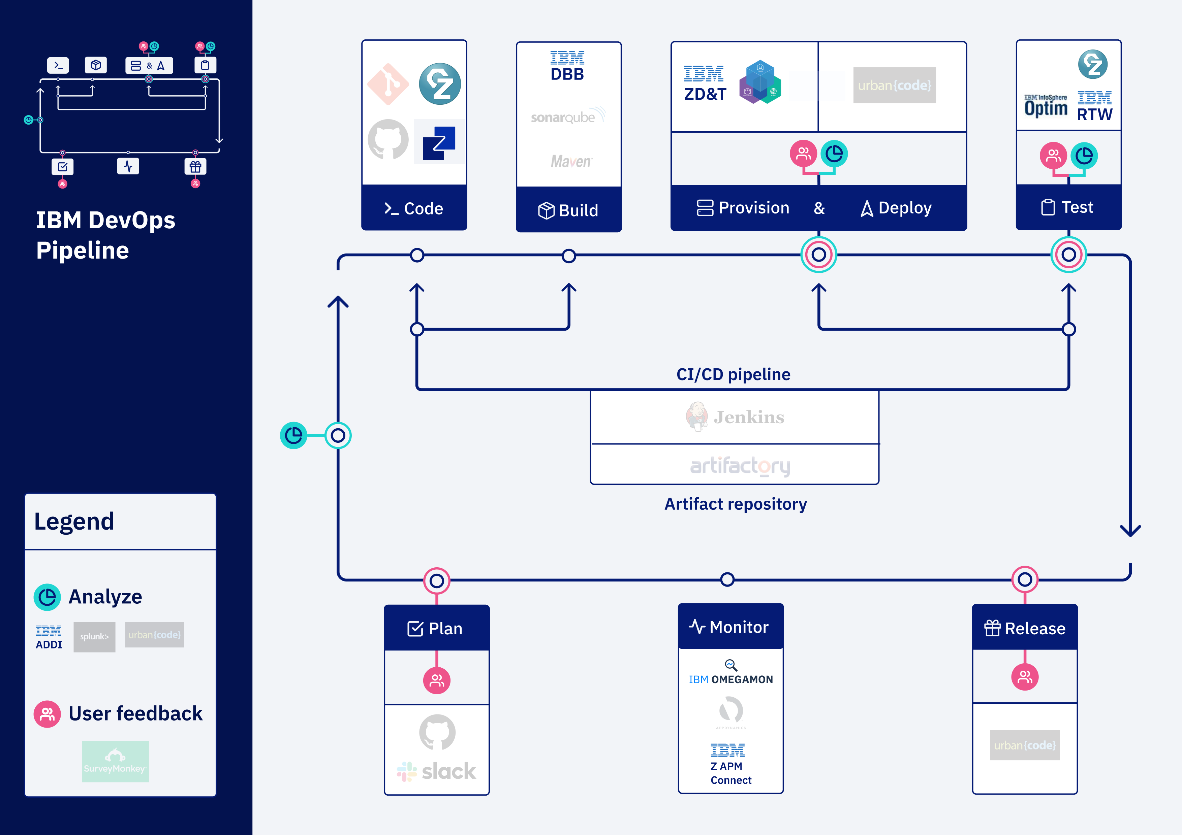
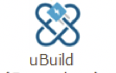




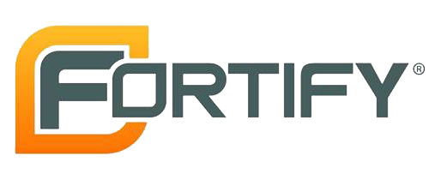







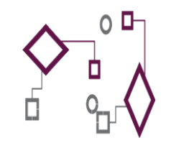













EL
Code
IBM Dependency Based Build (Git)
Provision & Deploy
EL
Test
IBM Developer for Z
EL
Build
Z Open Development
IBM Z Development and Test Environment
Z Open Unit Test
RTW
EL
Analyze
IBM Application
Discovery and Delivery Intelligence
CI/CD pipeline
Integrated Pipeline Example
Plan
Monitor
Release
LEGEND
IBM Z APM Connect
OMEGAMON
Operational Insights
Analyze
Feedback,
approvals

Slide 15
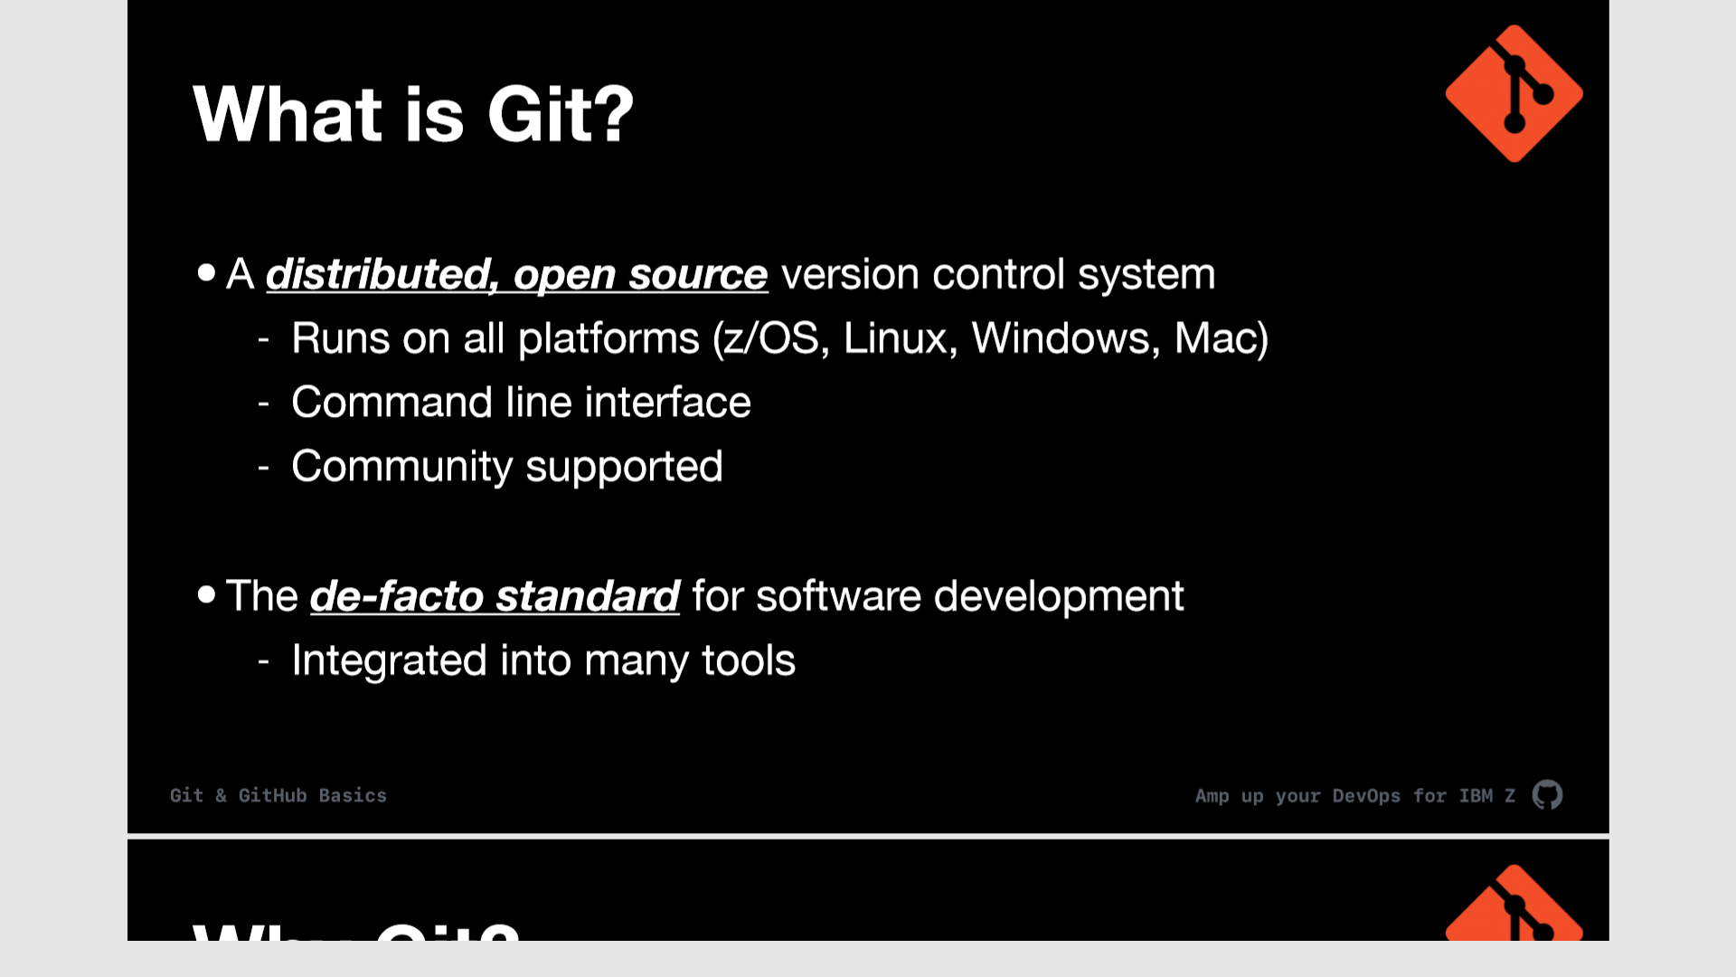


Slide 16
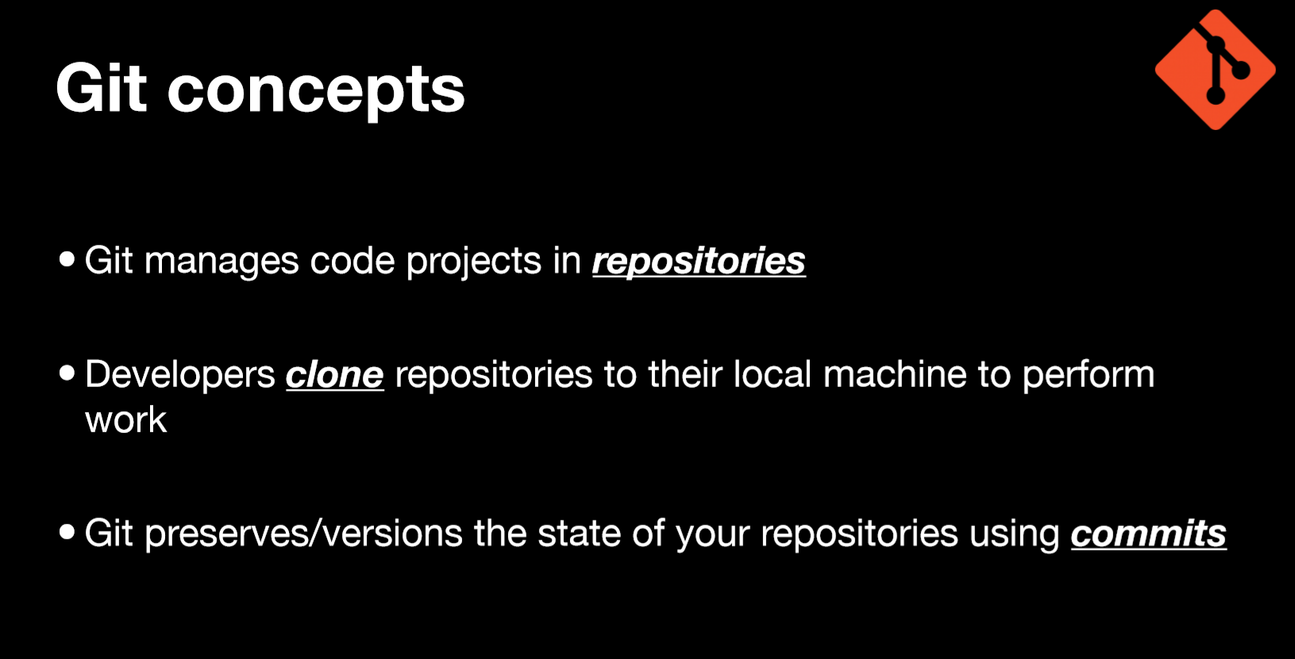
Git manages code projects in repositories
Developers clone repo(s) to their local PC to work
Developers create a branch to work in isolation
Git preserves/versions the state of a repo using commits
Developers use Pull Requests (GitHub) to merge their branch and initiate a pipeline

Slide 17
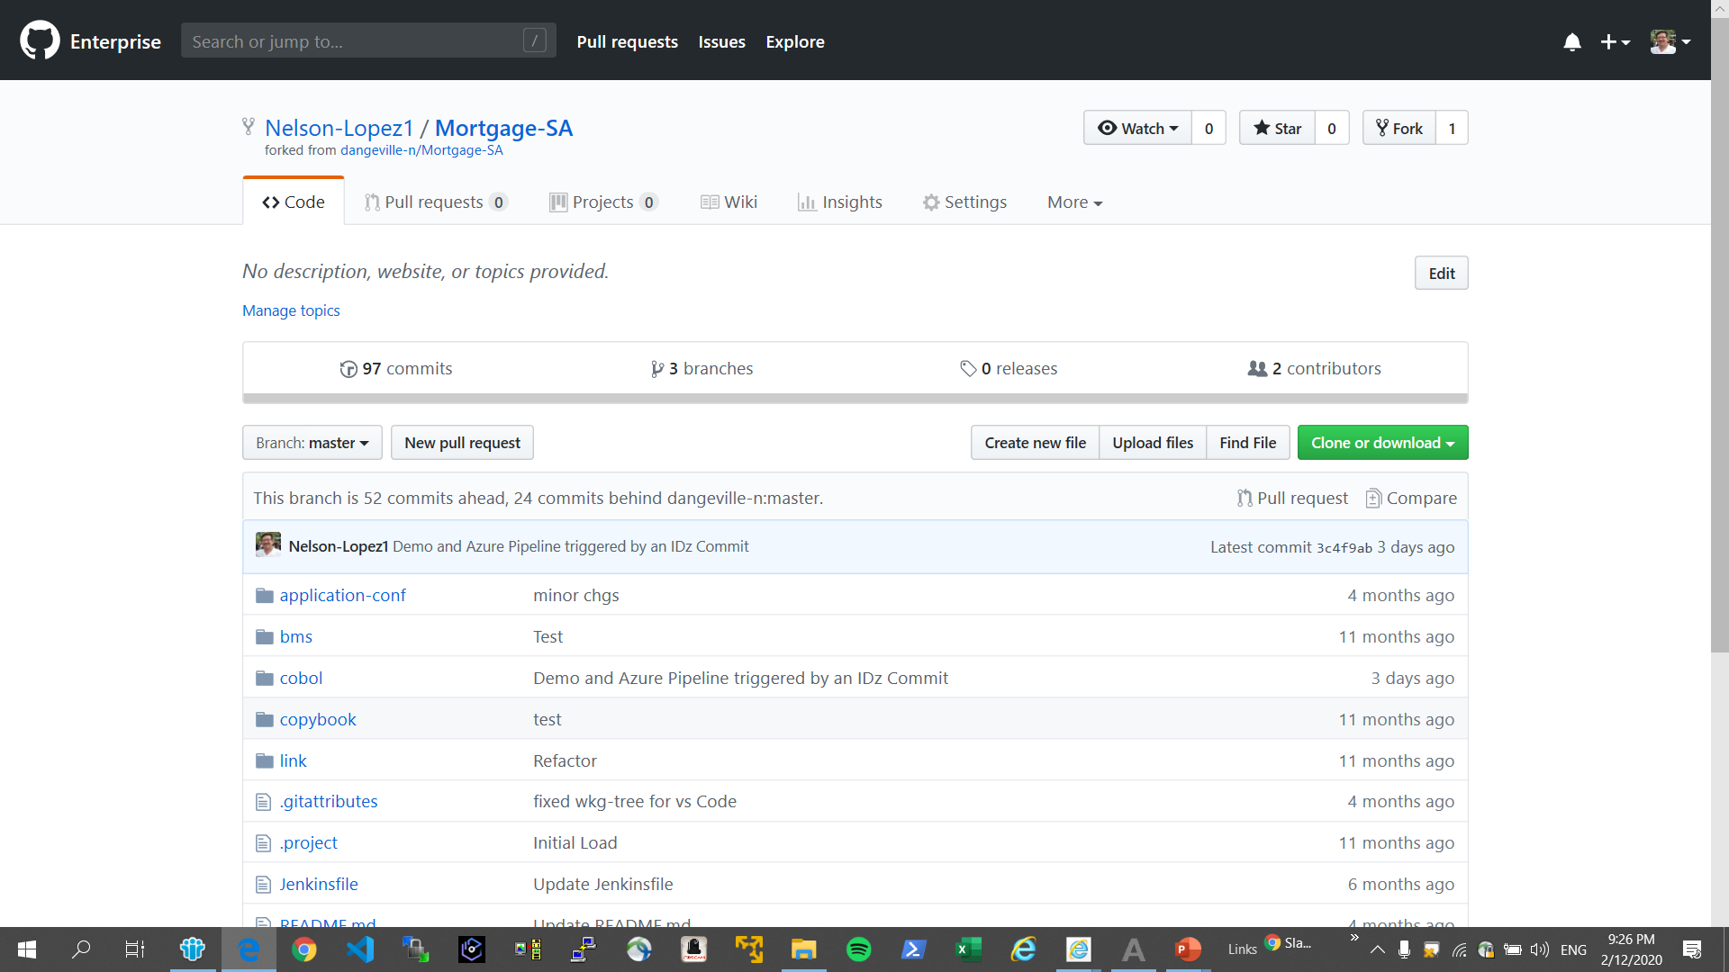
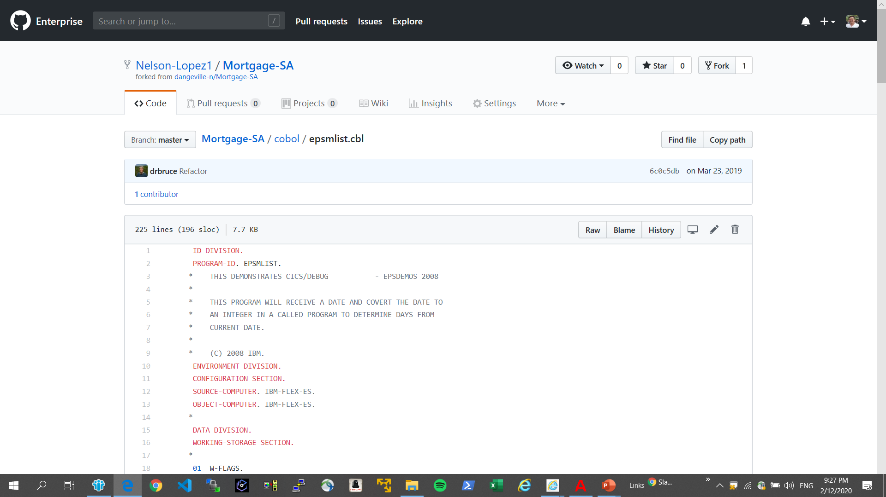
A sample Repo’s with consistent and well-defined folder structures and built-in documentation

Slide 18
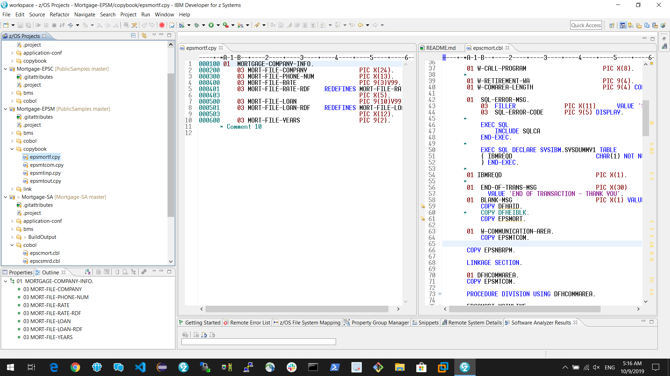
Repo’s simplify a developers view of an application

Slide 19
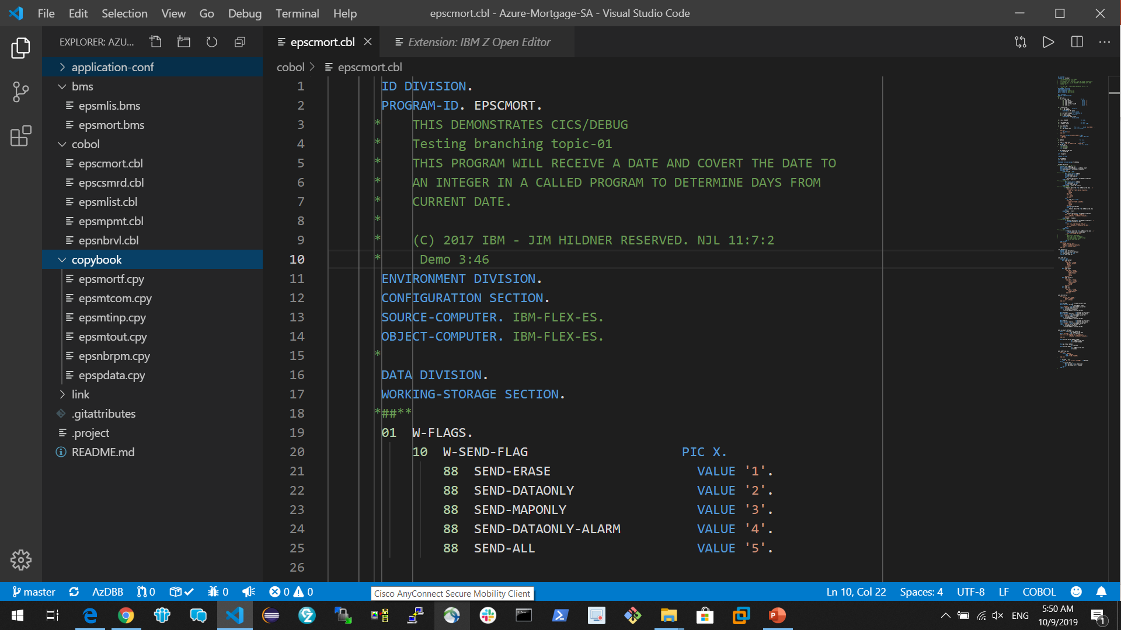
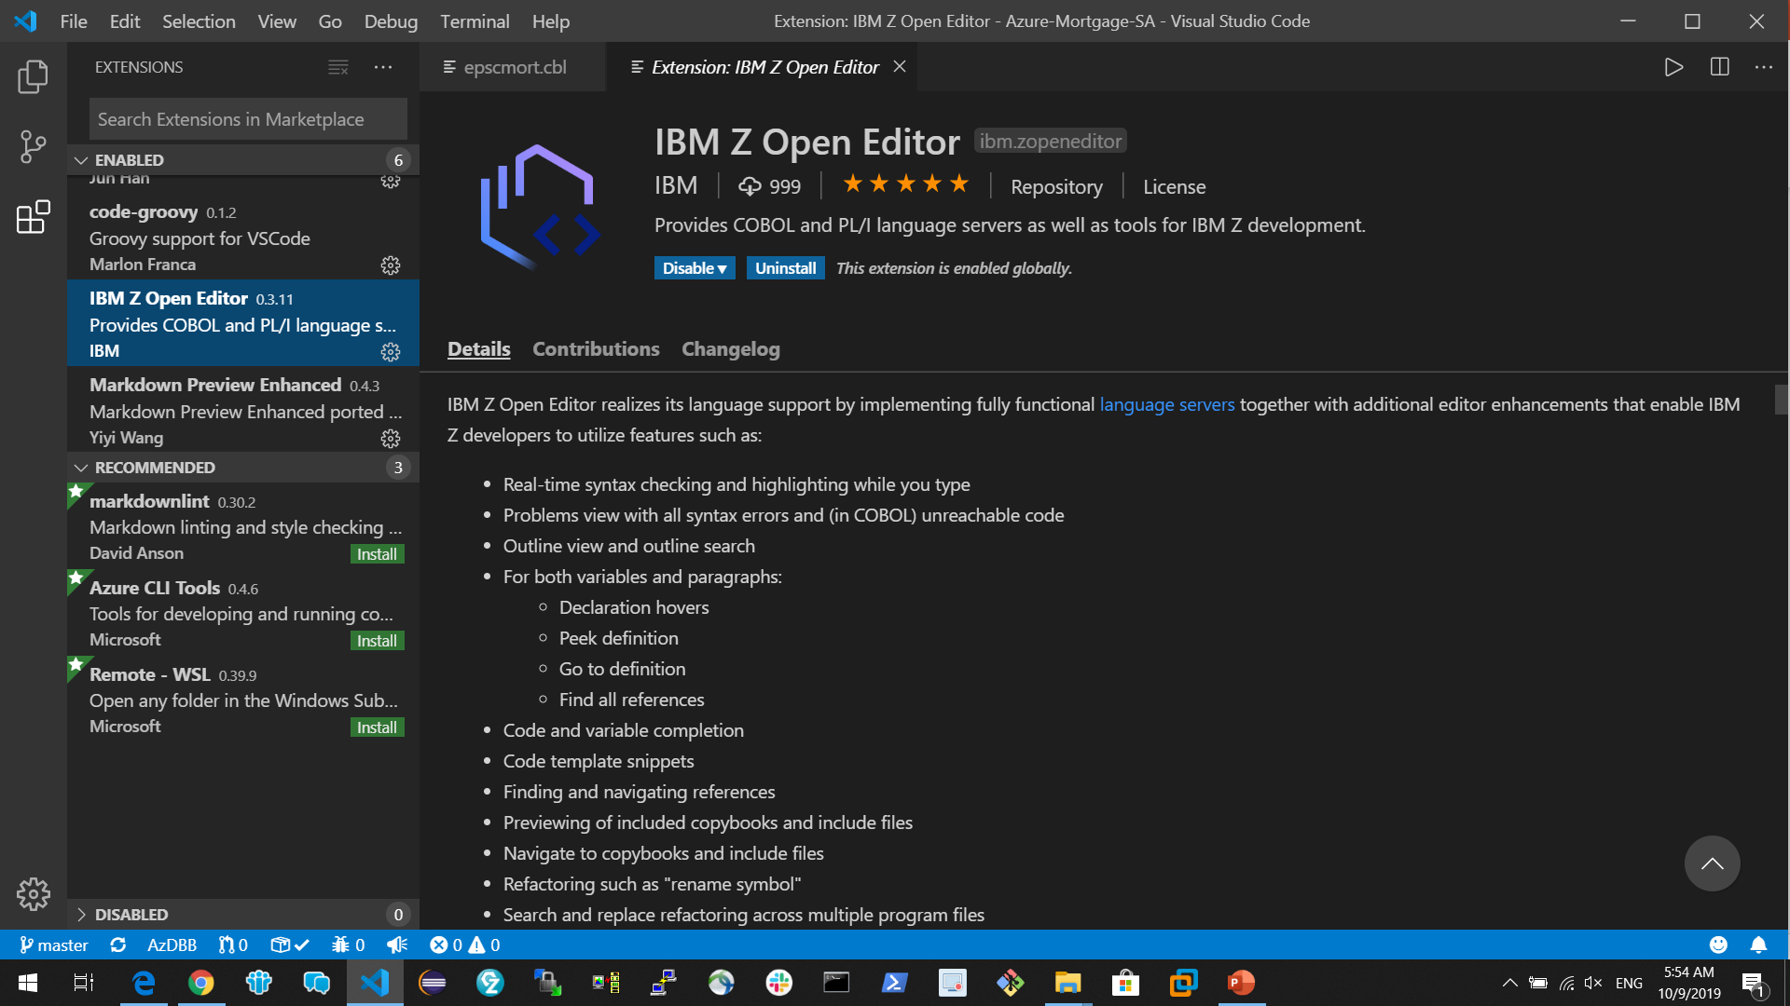
Tools for modern Development Git on VS Code with IBM Z Open Editor

Slide 20
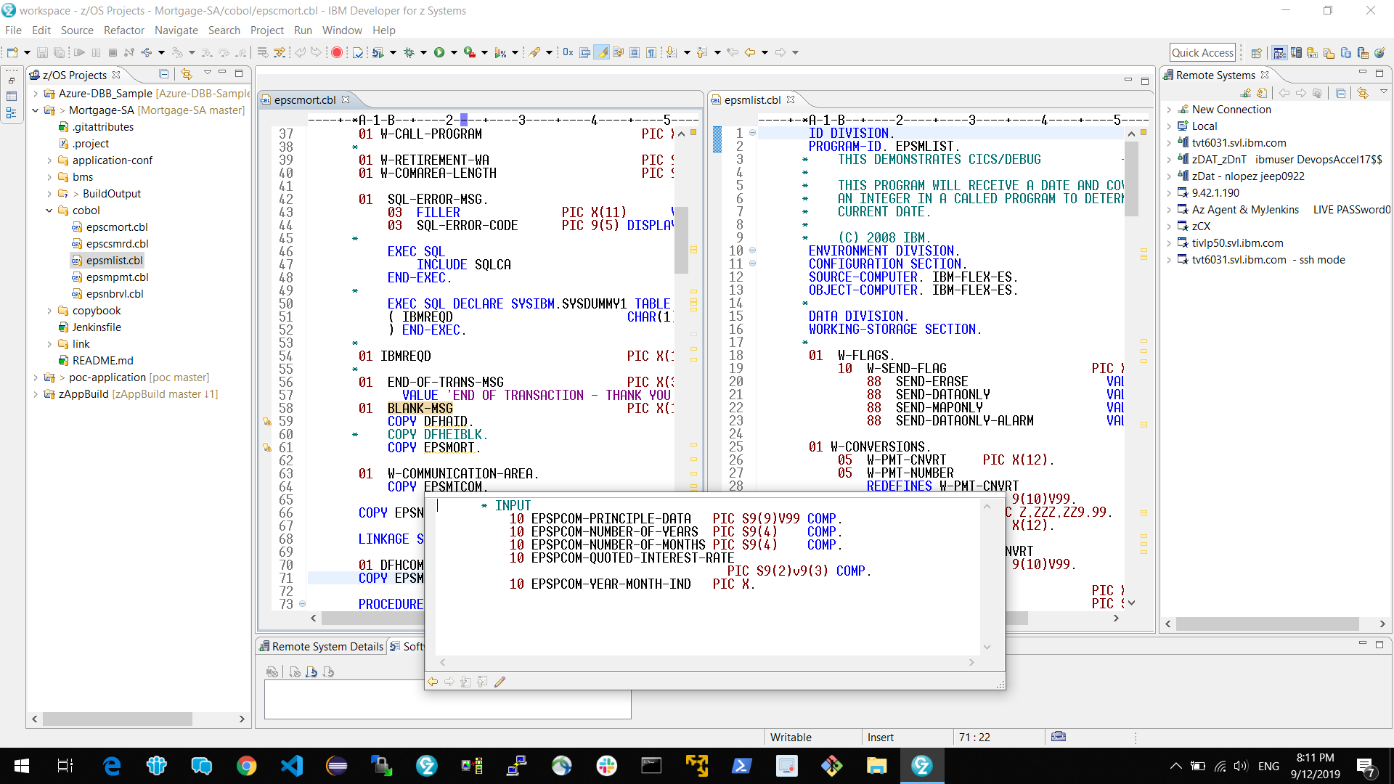
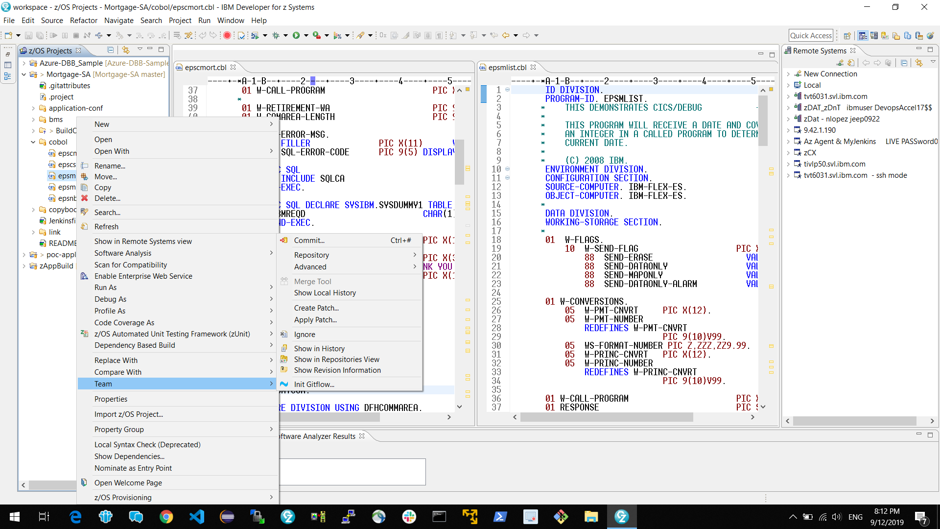
A day in the life of a Developer (Git and IDz)
Git clone & branch for isolation
DBB User Build
Test
Pull Request (GitHub)
Code review
Approval (merge branch)
Start a pipeline
Notes:
Related to slide 5

Slide 21

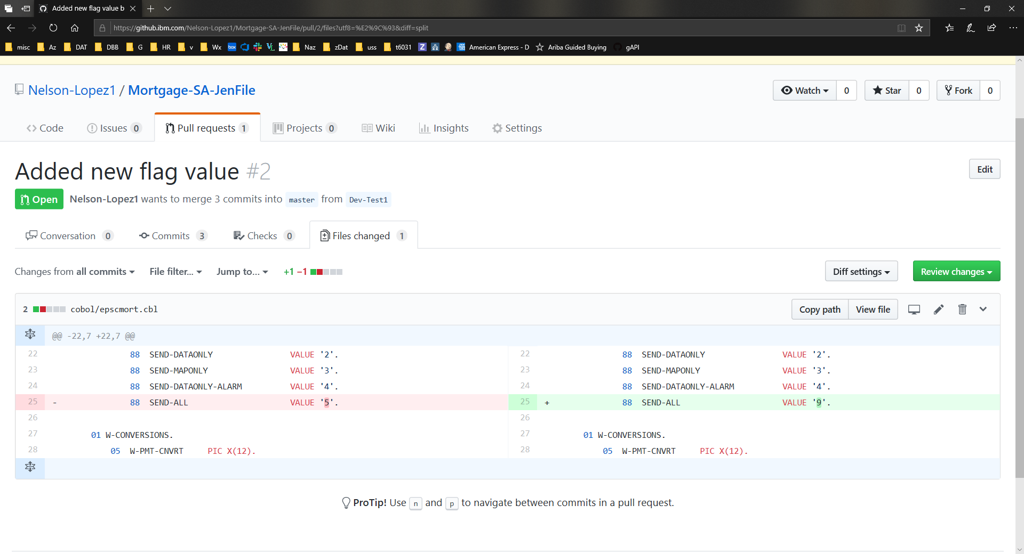
Peer Code Review
Diff between old vs new
Notes:
Note – break from slide and show a repo (time permitting)
Steps-
- access DBB repo (mort app)
- show commits
- show log

Slide 22
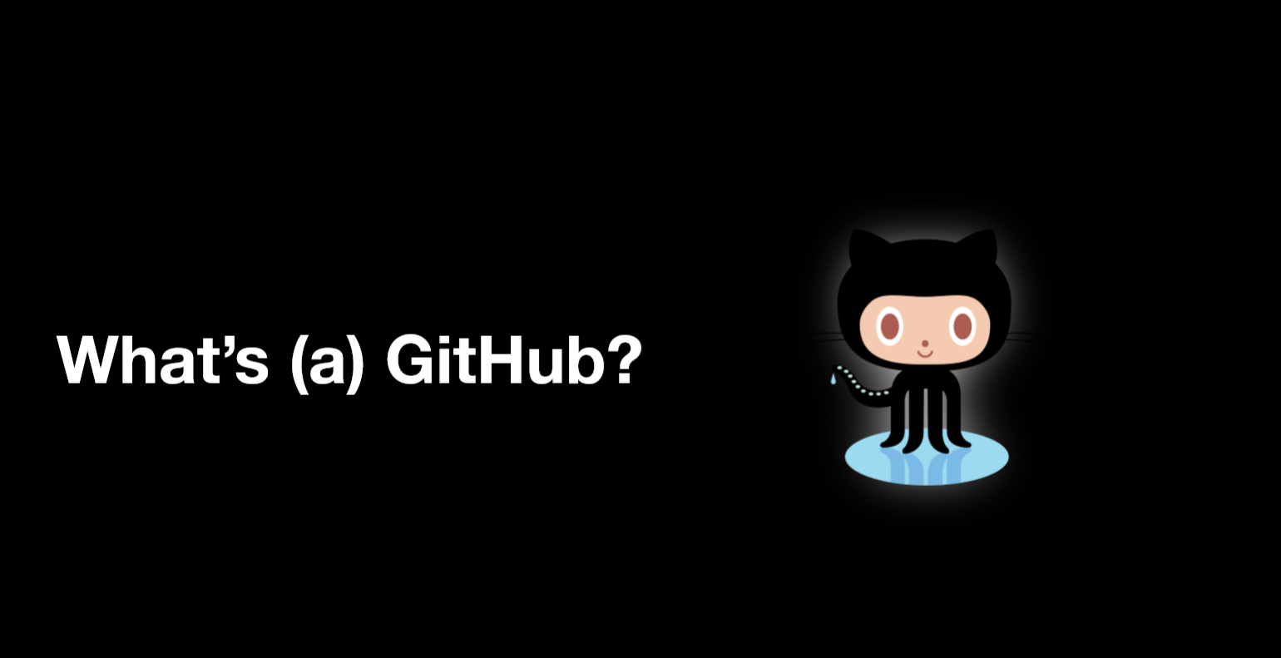

Slide 23
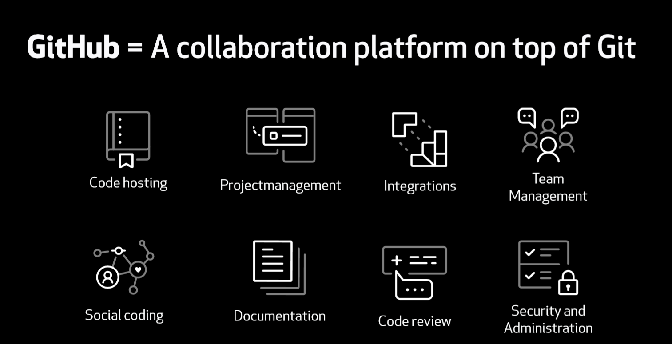

Slide 24
Git Branching Life Cycle

Slide 25
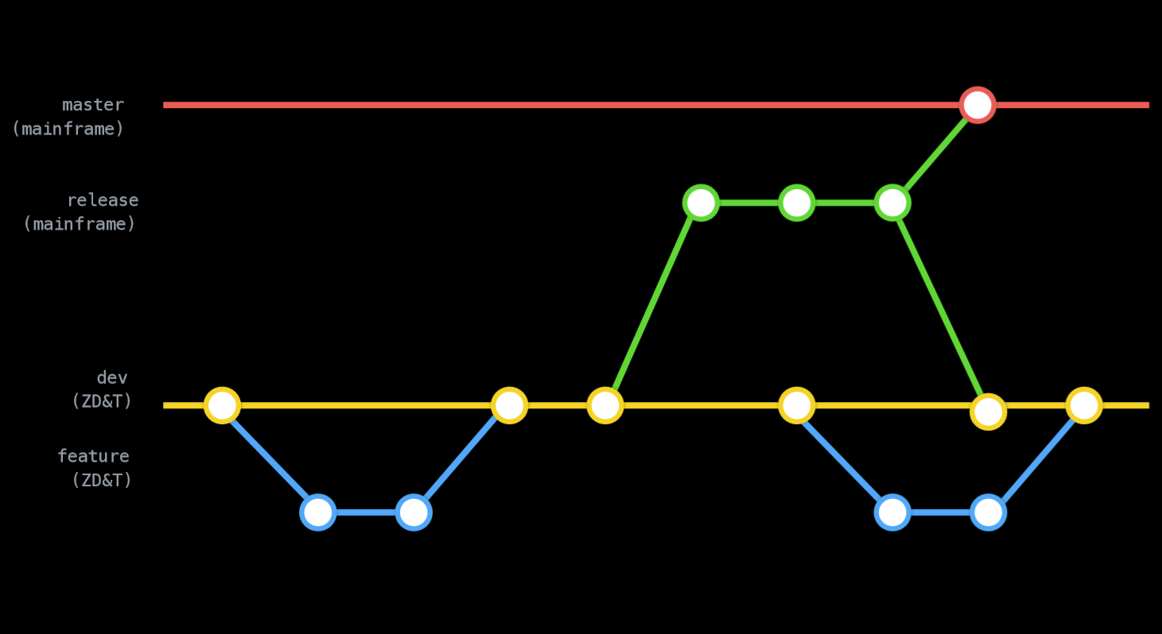
Multi Branch Repo Lifecycle -Git Flow
Master
Master Copy
Hot Fix
Release
Staging Area
Integration Branch
Dev
Developers -
Branch
Feature
FLOW
TIME
Notes:
https://www.atlassian.com/git/tutorials/comparing-workflows/gitflow-workflow

Slide 26
Git Repo Structures

Slide 27
Don't align repos to your org chart
“avoid deploying your org chart”
zyx
Dept1
T1
T2
Dept2
T3
Company
Dept
Teams
repo
repo
repo
Cross team dependencies add complexity,
more coordination and slows down release management

Slide 28
Align repos and teams along business functions
Customer Tracking
Account Receivable
Inventory
Common Services
App(s)
Copybooks…
Common
App(s)
Common
App(s)
Common
App(s)
Common
Create cross functional teams and repos by product lines

Slide 29
Repo Design Challenges
Goal
Working toward smaller light weight application designs to:
Reduce repo size and complexity
Reduce dev and test time
Reduce merge conflicts (drift)
Reduce time to market
Improve quality (shift left)
Reduce clutter in your IDE.
Repos can be redesigned as you gain more experience over time
Reality
Large Monolithic application designs
Sharing code (copybook)
Applications are not well documented
Some code has not been compiled in decades
This makes designing repos hard!

Slide 30
Design Tips - Git Folder Structures
What's in your Repo ?
Anything needed to build, test and deploy an application
Source code
Copy books
JCL
Test cases
BMS maps
Link Edit Cards
Rexx
Documents
Build and Configuration Properties
…..

Slide 31
Design Tips - Defining your Application Scope
What is an Application?
One or more logically related programs and their components
Designed for CICS, Batch, Distributed or a mix
Has a well-defined boundary, testable and as self contained as possible
Notes:
The goal is to strike a balance with the overall size and simply deployments with low dependency to external repo’

Slide 32
Considerations when sharing common code
Depends on many factors like:
Impact of Copybook changes (breaking vs non-breaking change)
Impact of dynamic and static sub-modules
Clear ownership of common objects
Collaboration between teams
Guess What – Its not new to them. Customers have been managing this for years.
Notes:
The goal is to strike a balance with the overall size and simply deployments with low dependency to external repo’
- Well define apps, you can create many smaller repos. Otherwise, you may need to add more luggage to one large

Slide 33
Considerations for a successful transition to Git
Design a git flow that works with your current best practices
Leverage distributed Dev team practices
Structure Repo’s to model your business lines
Standardize Repo folder structure to simplify development and cross team collaboration
Continuously improve your Git design
Leverage Agile practices of short sprints to reduce merge conflicts and release complexity

Slide 34
EL
Code
IBM Dependency Based Build (Git)
Provision & Deploy
EL
Test
EL
Build
IBM Developer for Z
Dependency Based Build DBB
Z Open Development
IBM Z Development and Test Environment
Z Open Unit Test
RTW
EL
Analyze
IBM Application
Discovery and Delivery Intelligence
CI/CD pipeline
Integrated Pipeline Example
Plan
Monitor
Release
LEGEND
IBM Z APM Connect
OMEGAMON
Operational Insights
Analyze
Feedback,
approvals

Slide 35
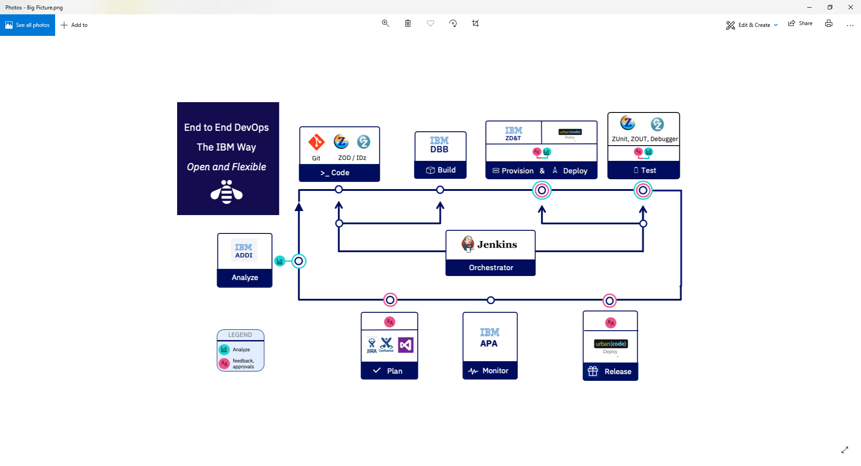
What is
IBM’s Dependency Based Build (DBB)?

Slide 36
DBB is a tool to automate the Build of mainframe applications – no JCL, ISPF, SDSF needed
It integrates with any modern IDE or SCM like Git
Automation through modern scripting languages like Groovy & Python under any pipeline Orchestrator like Jenkins, Azure DevOps, GitLab CI/CD …

Slide 37


DBB’s Intelligent Build
Source Repo
Dependencies between programs & copybooks are used to drive intelligent, efficient builds
Copybook1
PGM-A
Copybook2
PGM-B
Copybook3
PGM-C
Static Link

Slide 38

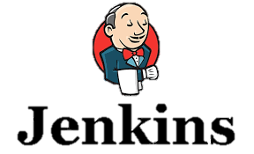





DBB Architecture (Continuous Integration Phase)
DBB WebApp
- Dependency Metadata
Build Results History
Start Job
Status, logs and links to reports
Logs
z/OS
DBB Toolkit
Agent
MVS API’s
PDS
Any Git Server
CLONE
Main Repository
CLONE to USS
Groovy Build scripts
Compile
&
link
Run Groovy build script
Return status and Logs
Scan, impact analysis, copy to PDS, compile, create artifacts, & report
Pull Request
USS
MVS
IDz
Notes:
Bookmark
Recap… git repo, branch and flow, dbb intelligent dependency based build
The 5 key terms in Git – repo, clone, branch, commit, pull request

Slide 39
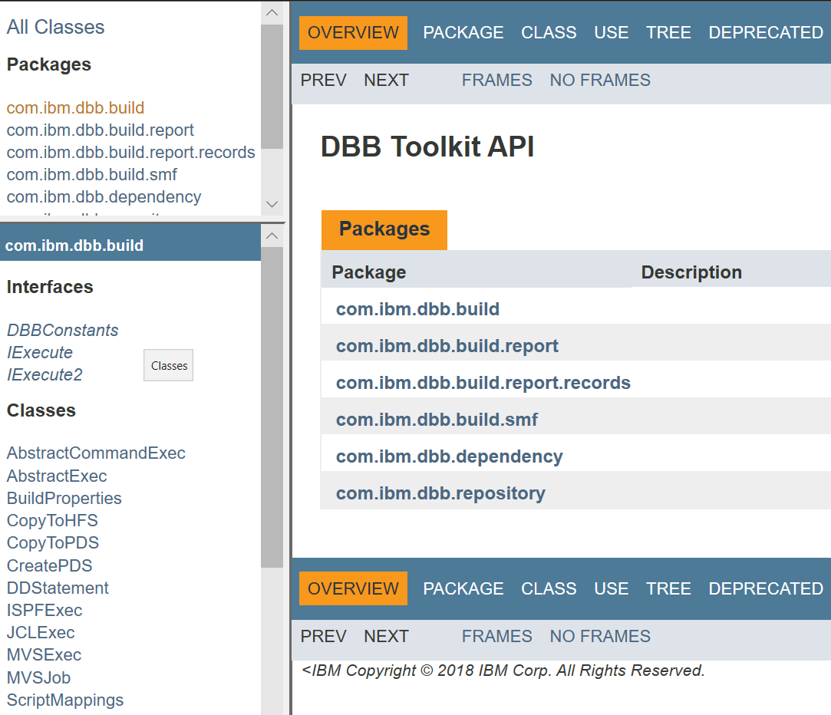
DBB Java API Toolkit
A set of Java APIs used to define scripts that:
Run MVS programs, TSO/ISPF commands, Submit JCL
Scan, store and retrieve application dependency metadata
Utilities to copy to/from PDS’s and USS zFS
Migrate source from PDS’s to Git

Slide 40
DBB Groovy Starter Kit – aka zAppBuild
zAppBuild is set of sample Groovy scripts used to run a DBB Build (Compile and Link)
Its generic and customizable
builds any z/OS application (COBOL, Assembler, PL1)
delivered with the product or from our Public GitHub Site
Supports IDz User Builds and full Pipeline Builds
Main Purpose - accelerate client adoption of DBB
https://github.com/ibm/dbb
Notes:
Show the zAppBuld READ.ME

Slide 41
zAppBuild - Supported Build Actions
Single Program – Build a single program in the application. Mainly used by IDz User Build.
List of Programs – Build a list of programs provided by a text file
Full Build – Build all programs (or buildable files) of an application
Impact Build – Build only the programs impacted by source files that have changed since the last successful build. Mainly used in Pipeline builds.
Scan Only – Scans the source code to pre-populate the DBB WebApp’s data base with application dependency meta-data (like copy books)

Slide 42
zAppBuild workflow
Initialize Build
Create Build List
Process Build List
Finalize Build
Load properties
Initialize Build Report and build result
Create Data Sets if needed
Process build option
User build, full build, impact, etc.
Find appropriate language script to run (cobol, asm..)
Run Language script
Run additional processes (file level)
Run additional processes (build level)
Mark Build as finished with status
Add git hashes
Upload logs and reports
Scan changed files
Perform impact analysis
Connect to WebApp
List of files to build

Slide 43
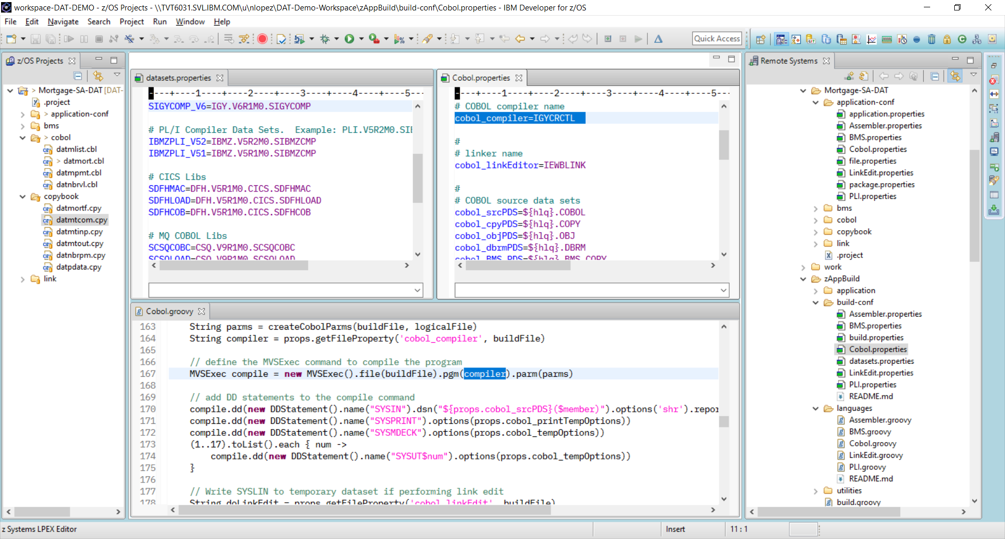
Application-conf file.properties
Notes:
Build properties for a sample application

Slide 44
Notes:
What we want to do is provide this pipeline as the automation framework for the DevOps transformation

Slide 45
Pipeline Demo … (15 min)
NOTE:
If you’d like of participate in my upcoming lab tomorrow
Please email DAVID BEAN for access to our latest zTrial image
For material and more info see the slack channel
#dat-lab
Notes:
Use slide # 5 for context (aka the inner/outer loop discussion)
Lab – create a repo, create a dbb migration script and run it from an ssh term =, clone your repo in Idz, make a change and push it back

Slide 46
IBM Z Open Automation Utilities V1.0.0

Slide 47
Example – Copy four files from HFS to PDSE
JCL
ZOAU
//*
//DCPI EXEC PGM=IEBGENER
//SYSIN DD DUMMY
//SYSPRINT DD SYSOUT=*
//SYSUT1 DD PATH='/tmp/interest.cobol', +
// RECFM=FB,LRECL=80,BLKSIZE=32720
//SYSUT2 DD DSN=@@HLQ@@.ZOASAMP.PROJ23.COBOL(INTEREST),DISP=SHR
//DCPB EXEC PGM=IEBGENER
//SYSIN DD DUMMY
//SYSPRINT DD SYSOUT=*
//SYSUT1 DD PATH='/tmp/mobile.cobol', +
// RECFM=FB,LRECL=80,BLKSIZE=32720
//SYSUT2 DD DSN=@@HLQ@@.ZOASAMP.PROJ23.COBOL(MOBILE),DISP=SHR
//DCPM EXEC PGM=IEBGENER
//SYSIN DD DUMMY
//SYSPRINT DD SYSOUT=*
//SYSUT1 DD PATH='/tmp/mortgage.cobol', +
// RECFM=FB,LRECL=80,BLKSIZE=32720
//SYSUT2 DD DSN=@@HLQ@@.ZOASAMP.PROJ23.COBOL(MORTGAGE),DISP=SHR
//DCPP EXEC PGM=IEBGENER
//SYSIN DD DUMMY
//SYSPRINT DD SYSOUT=*
//SYSUT1 DD PATH='/tmp/payment.cobol', +
// RECFM=FB,LRECL=80,BLKSIZE=32720
//SYSUT2 DD DSN=@@HLQ@@.ZOASAMP.PROJ23.COBOL(PAYMENT),DISP=SHR
Shell
dcp /tmp/*.cobol "${HLQ}.PROJ23.COBOL"
Java
Datasets.copy("/tmp/*.cobol", HLQ+".PROJ23.COBOL");
Python
Datasets.copy(source="/tmp/*.cobol",
target="%s.PROJ23.COBOL" % HLQ))
Notes:
Rewriting to be pure C (instead of shell script)
Target Persona are systems programmers/admins/operations who create Artifactory playbook for deployment tasks

Slide 48
Run commands from a USS command line
ZOA Utility shell commands are designed for programmers familiar with Linux and UNIX
The commands have a name and syntax that is familiar to UNIX developers. Ex. the dls command lists data sets and is modeled on the UNIX ls command.
The ZOA Utility commands are true UNIX System Services commands
Piping and redirection of stdin, stdout, and stderr is supported.
This makes it easy and natural to incorporate the ZOA commands into shell and bash scripts requiring no complex dependencies.
Man page documentation is provided for the ZOA Utility commands and are accessed the same as any other UNIX man pages.

Slide 49
Shell Script Example
echo "Write 3 records to master dataset"
decho "Charles Field 278 323 6045" "${master}"
decho -a "David George 397 132 6025" "${master}"
decho -a "William Young 178 333 5045" "${master}"
echo "Write 3 records to new dataset"
decho "Emma Hill 149 589 5045" "${new}"
decho -a "Sharon Miller 153 232 6045" "${new}"
decho -a "Steve Green 748 111 6025" "${new}"
echo "Write the command string to the command dataset"
decho " MERGE FORMAT=CH,FIELDS=(1,9,A)" "${cmd}"
args="MSGPRT=CRITICAL,LIST"
echo "The arguments to the SORT program for performing the merge are: ${args}"
echo "Run the SORT program to perform the merge."
echo "SORTIN01 DD name points to the master (old) dataset: ${master}"
echo "SORTIN02 DD name points to the new dataset: ${new}"
echo "SYSIN DD name points to the commands dataset: ${cmd}"
echo "SORTOUT DD name points to the resulting merged dataset: ${merge}"
echo "SYSOUT DD name points to the console for output from the program"
mvscmd --pgm=SORT --args="${args}" --sortin01="${master}" --sortin02="${new}"
--sysin="${cmd}" --sortout="${merge}" --sysout=*
rc=$?

Slide 50
Call APIs in Java and Python programs
ZOA Utilities provides easy-to-use Java and Python class libraries for accessing MVS resources such as data sets directly from the language.
Python
from zoautil_py import MVSCmd, Datasets
from zoautil_py.types import DDStatement
import logging
import logging.config
logging.config.fileConfig('logging.conf')
# Create list of DD statements for MVSCmd
dd_statements = []
dd_statements.append(DDStatement(ddName="sortin01", dataset="USR.MVSCMD.DFSORT.MASTER"))
dd_statements.append(DDStatement(ddName="sortin02", dataset="USR.MVSCMD.DFSORT.NEW"))
dd_statements.append(DDStatement(ddName="sysin", dataset="USR.MVSCMD.DFSORT.CMD"))
dd_statements.append(DDStatement(ddName="sortout", dataset="USR.MVSCMD.DFSORT.MERGE"))
dd_statements.append(DDStatement(ddName="sysout", dataset="*"))

Slide 51
Java
package com.ibm.merge;
import com.ibm.zoautil.DatasetOptions;
import com.ibm.zoautil.DatasetType;
import com.ibm.zoautil.Datasets;
import com.ibm.zoautil.MVSCmd;
import com.ibm.zoautil.RecordFormat;
import com.ibm.zoautil.types.DDStatement;
public class Merge
{
public static void main(String[] args) throws IOException
{
String hlq = "BUILDER";
String dsPrefix = hlq + "." + mlq;
String dsMaster = dsPrefix + ".master";
// Options to create a fixed block 80 sequential data set
DatasetOptions createDSOptions = new DatasetOptions().type( DatasetType.SEQ )
.recordFormat( RecordFormat.FB ).lrecl( 80 ).maxRC( 8 );
// Create Master dataset
Datasets.create( dsMaster, createDSOptions );
Datasets.write( dsMaster, "Charles Field 278 323 6045" ); // write
Datasets.write( dsMaster, "David George 397 132 6025", true ); // append
Datasets.write( dsMaster, "William Young 178 333 5045", true ); // append

Slide 52
Benefits of ZOA Utilities
Enables easier calling of MVS utilities compared with JCL
Provides natural coding experience on UNIX System Services
Provides interfaces in modern programming languages

Slide 53
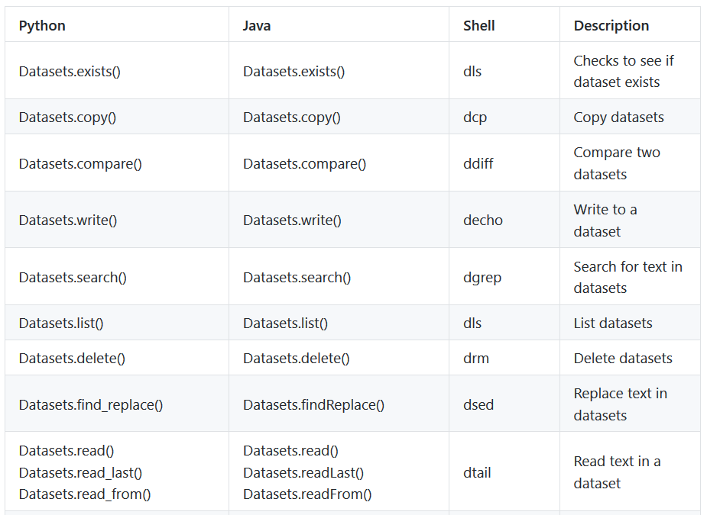
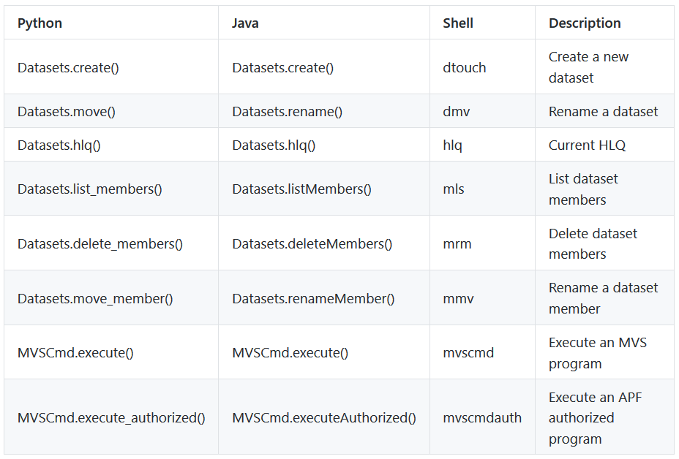
ZOA Utilities v1.0 Commands

Slide 54
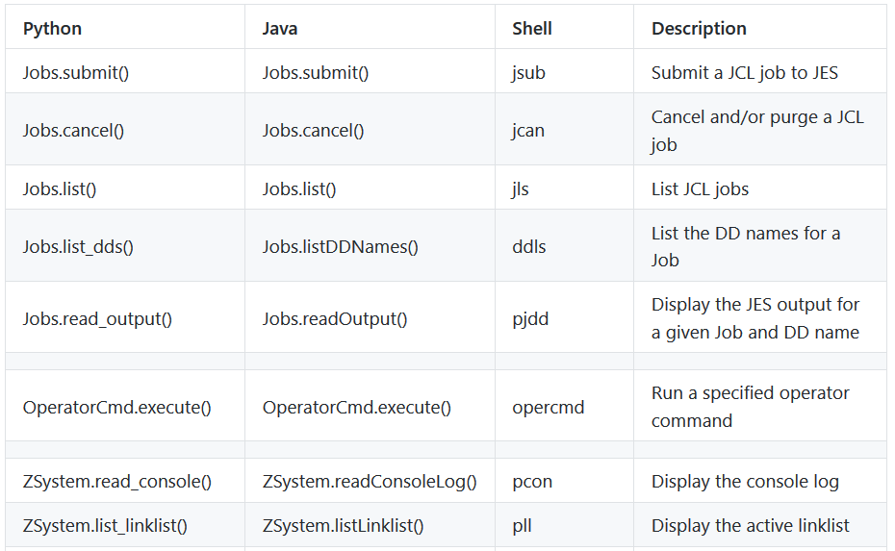
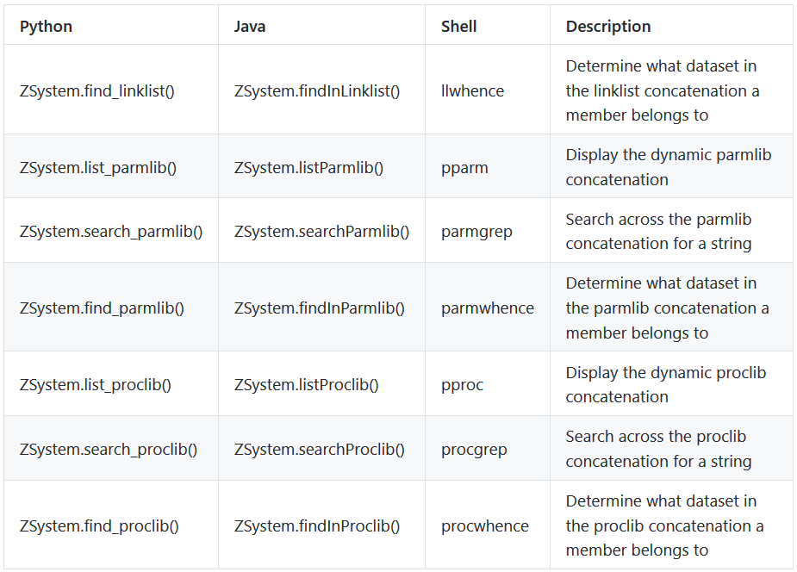
New Commands Under Development

Slide 55
Availability
The ZOA Utilities is packaged as part of the latest versions of the following products:
IBM Application Delivery Foundation for z Systems
IBM Developer for z Systems Enterprise Edition
IBM Z Open Development
IBM Dependency Based Build

Slide 56
ZOA Utilities Knowledge Center
https://www.ibm.com/support/knowledgecenter/SSKFYE_1.0.0/welcome_zoautil.html
Table of contents include:
Functional Overview
Installation and configuration
Example of merging data sets in each supported language
Instructions on extending ZOA Utilities to other languages
Command and API references
Messages reference

Slide 57
Debugging – Common Problems
Q: What shall I do to cope with the following message?
FSUM7332 syntax error: got (, expecting Newline
A: This might happen if you do not set _BPXK_AUTOCVT. To fix this, make sure that you have issued the following command before running the utilities:
export _BPXK_AUTOCVT=ON
Q: I cannot use the dls, dmv, mmv, mrm or dlsraw commands. How can I fix it?
A: If commands such as dls, dmv, mmv, mrm or dlsraw fail for you, but other commands work, check whether you have mvscmdauth installed correctly as follows:
Issue type -a mvscmdauth to determine where mvscmdauth is installed. In this example, we assume that mvscmdauth is installed in /usr/lpp/IBM/zoautil.
Issue ls -E /usr/lpp/IBM/zoautil. If mvscmdauth is installed correctly, the first two columns read like -rwxr-xr-x a---. In particular, if the ‘a’ is not present, mvscmdauth is not APF-authorized. To set the APF authorization bit on, issue extattr +a /usr/lpp/IBM/zoautil. If it is still not set afterward, you probably do not have permission to do it, and you should consult your systems programmer.

